Slide 1
Introduction to Biology
Jennifer Naples
Direct Instruction Biology

Slide 2
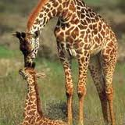
What is Biology?
Biology is the study of life
Bio – life
Ology – the study of something
Biologists use the scientific method to study living things.

Slide 3
The Scientific Method
The scientific method is a series of steps that are used to answer a question
There are different views on the steps involved in The Scientific Method

Slide 4
The Scientific Method
The steps of The Scientific Method:
Form a question or state the problem
Gather information
Create a hypothesis
Set up a controlled experiment
Record and analyze results
Draw conclusions

Slide 5
The Scientific Method
Step 1
Ask a question or state the problem
The question needs to be reasonable and testable.
I am mot performing well on tests. If I eat breakfast in the morning will it help my test scores?
Create your own testable question.

Slide 6
The Scientific Method
Step 2
Gather Information
Facts about dependent and independent variables
Effects of lack of nutrition
What can be done to improve test scores

Slide 7
The Scientific Method
Step 3
Create a hypothesis
A hypothesis is an educated guess, a statement that you think will be the conclusion to your experiment
If I eat breakfast, my test scores will be higher.
Create your own hypothesis for your question.

Slide 8
The Scientific Method
Step 4
Create an experiment
The experiment must be repeatable and include a manipulated variable and a responding variable
Manipulated variable – eating or not eating breakfast. This is the variable that you have control over
Responding variable – test scores. This variable changes in response to the manipulated variable.

Slide 9
The Scientific Method
Step 5
Record and analyze your results
Recording can be done on a chart or in sentence form.
Analyzing results may include creating a graph
I will create a chart that keeps record of my test scores when I eat breakfast and when I do not eat breakfast

Slide 10
The Scientific Method
I will make a line graph which compares the results of test scores with breakfast and test scores without breakfast
What will you do to record your data?
How will you analyze your data?

Slide 11
The Scientific Method
Step 6
Draw conclusions
Conclusions are made based on results and analyzing data.
When I eat breakfast, my test scores are higher. Breakfast helps to give your brain the fuel that it needs to function at its best.

Slide 12
The Scientific Method
Activity
You will need:
1 blank sheet of paper
Pencils and colored pencils or markers
Fold paper so there are 6 blocks. Create a cartoon using the steps of The Scientific Method. Create an imaginary question, hypothesis, experiment, results and conclusion. Put one step in each block.

Slide 13
Theory
What is a theory?
A unifying EXPLANATION for a broad range of hypothesis that have been supported by testing.
Theories explain and predict.
Big Bang Theory
Evolution

Slide 14
Thoery
https://www.youtube.com/watch?v=d80Lf76Ht18

Slide 15
Law
What is a law?
A scientific summary of many experimental test results and observations.
Tell you what happens
Newtons laws
Gravity

Slide 16
Theory VS. Law
Check for understanding and practice
Fold a piece of paper in half
Cut on half of the paper down the middle
Use one half for theories and one half for laws
Give a definition and examples of each
Draw a picture for each example

Slide 17
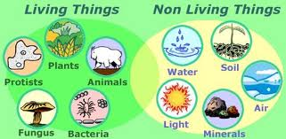
Characteristics of Living Things

Slide 18
Characteristics of Living Things
All living things share some common characteristics:
They are all made up of cells
They reproduce
They are based on a universal genetic code
They grow and develop
They obtain and use materials and energy
They respond to their environment
They maintain a stable internal environment
Taken as a group, they change over time

Slide 19
Branches of Biology
Biology is the study of all living things
Because there is such diversity in living things, there are many branches of biology
Botany – the study of plants
Zoology – the study of zoo animals
Marine Biology – The study of living organisms which live in and/or around water
What is another branch of biology?

Slide 20
Tools and Procedures in Biology
Scientists of all types from around the globe use the metric system as their system of measurement
The metric system is based on units of 10
The “newer” revised version of the metric system is called the International System or SI.

Slide 21
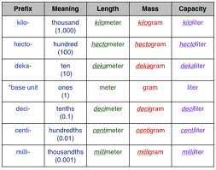
Metric System

Slide 22
Practice Problems
How many centimeters are in a meter?
100
How many milligrams in a gram?
1000
How many milliliters in a liter?
1000

Slide 23
Microscopes
Light Microscope
Most commonly used
Can magnify a specimen about 1000 times
Compound light microscopes allow light to pass through a specimen
Chemical stains are often used to show structures
Fluorescent dyes are combined with video cameras and computers to create moving 3-D images

Slide 24
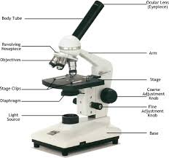
Compound Light Microscope
Diagram

Slide 25
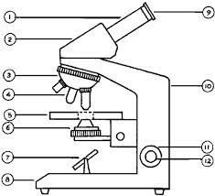
Compound Light Microscope
Label the diagram:

Slide 26
Electron Microscope
Use beams of electrons to produce images rather that light
Up to 1000 times more detailed that a Compound Light Microscope
Specimens must be dehydrated and preserved
There are two types of Electron Microscopes
TEM
SEM

Slide 27
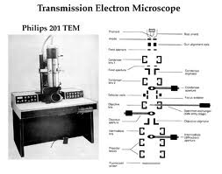
Transmission Electron Microscope
Shines a beam of electrons through a specimen
Can reveal detail inside a cell

Slide 28
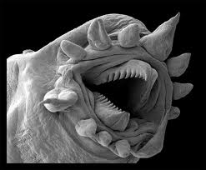
Scanning Electron Microscope
Scan a narrow beam of electrons back and forth across the surface of a specimen
Produce realistic 3-D images of the surface of objects
A parasite
under an SEM
microscope

Slide 29
Lab Techniques in Biology
There are many techniques that biologists use to study cells
Cell cultures
Cell fractionation

Slide 30
Cell Cultures
A single cell is placed into a dish with a nutrient solution where the cell can reproduce into a group of cells called a cell culture.
Used to study cell responses under controlled conditions
Used to study interactions between cells
Used to select specific cells for further study.

Slide 31
Cell Fractionation
Separates one part of the cell from the rest
Cells are broken into pieces in a special blender
Broken cell bits are added to a liquid and placed in a tube
The tube is placed into a centrifuge which spins the tube
Spinning separates the parts based on their mass and specific parts can be selected and studied

Slide 32
Check for Understanding
What kind of microscope is used in biology class?
Compound microscope
What kind of microscope will create a 3-D image?
Scanning Electron Microscope
What technique would you use to look at the individual parts of a cell?
Cell Fractionation

